Slide 1


Slide 2
What is Software Construction
The term software construction refers to the detailed creation of working software through a combination of coding, verification, unit testing, integration testing, and debugging.
It is most strongly linked to Software Design and Software Testing because the software construction process involves significant software design and testing.
(swebok)
Notes:
In computer programming and software development, debugging is the process of finding and resolving bugs within computer programs, software, or systems.

Slide 3
Introduction
Software construction closely tied to
Software design
Software testing
Design
Construction
Testing
Notes:
Construction is also sometimes known as "coding" or "programming." "Coding" isn't really the best word because it implies the mechanical translation of a preexisting design into a computer language; construction is not at all mechanical and involves substantial creativity and judgment. Throughout the book, I use "programming" interchangeably with "construction."

Slide 4
Introduction
Software construction typically produces the highest number of configuration items that need to be managed in a software project (source files, documentation, test cases, and so on).
Thus, the Software Construction is also closely linked to the Software Configuration Management.
Notes:
software configuration management is the task of tracking and controlling changes in the software

Slide 5
Software Construction Fundamentals
Minimizing complexity
Anticipating change
Constructing for verification
Reuse
Standards in software construction

Slide 6
Minimizing Complexity
Humans are severely limited in our ability to hold complex information in our working memories
As a result, minimizing complexity is one the of strongest drivers in software construction
Need to reduce complexity throughout the lifecycle
As functionality increases, so does complexity

Slide 7
Minimizing Complexity
Accomplished through use of standards
Examples:
UML for modeling all aspects of complex systems
High-order programming languages such as C++ and Java
Source code formatting rules to aid readability
Notes:
High Order Programming Languages are usually defined by interpreters that are themselves written in a programming language.

Slide 8
Anticipating Change
Software changes over time
Anticipation of change affect how software is constructed
This can effect
Handling of errors
Source code organization
Code documentation
Coding standards

Slide 9
Constructing for verification
Construct software that allows bugs to be easily found and fixed
Examples:
Enforce coding standards
Helps support code reviews
Unit testing
Organizing code to support automated testing
Restricted use of complex or hard-to-understand language structures

Slide 10
Reuse
Reuse refers to using existing assets in solving different problems.
In software construction, typical assets that are reused include libraries, modules, components and source code.
Reuse is best practiced systematically, according to a well-defined, repeatable process.
Systematic reuse can enable significant software productivity, quality, and cost improvements.

Slide 11
Standards in Construction
Standards which directly affect construction issues include:
Programming languages
E.g. standards for languages like Java and C++
Communication methods
E.g. standards for document formats and contents
Tools
E.g. diagrammatic standards for notations like the Unified Modeling Language
Notes:
J2EE= a standalone Java environment used by the software developers for building and deploying a web-based application or a website. J2EE technology provides a platform for developers with enterprise features such as distributed computing and web services

Slide 12
Software
Software is a collection of instructions and data that tell a computer how to work.

Slide 13
Software Engineering
Software engineering is an engineering discipline that is concerned with all aspects of software production from the ready stages of system specification to maintaining the system after it has gone into use.

Slide 14
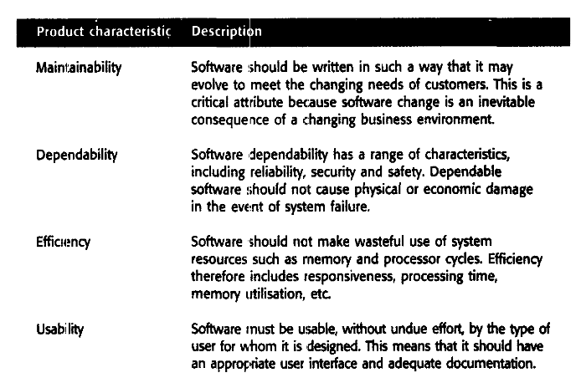
Characteristics of A GOOD SOFTWARE

Slide 15
The Software Development Process
Why To Use Software Development Process?
"It is better not to proceed at all, than to proceed without method." --Descartes

Slide 16
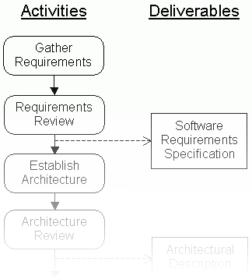
A Software Development Process Organizes the Activities of Software Development
. . . . . .
Review
System
Manage
Test
Risks
Create
Prototype
Unit
Test
Design
Gather
Implement
Requirements
Integrate
Rework
Correct
Mistakes
Developing software without a defined process is chaotic and inefficient
Following a defined process makes software development more orderly, predictable and repeatable

Slide 17
What is Software Process ?
Activities and results that produce a software product
A framework for the activities, actions, and tasks that are required to build high-quality software.
A generic process for software engineering defines five framework activities
Communication
Planning
Modeling
Construction
Deployment
Software evolution
Notes:
In computer programming, a software framework is an abstraction in which software providing generic functionality can be selectively changed by additional user-written code, thus providing application-specific software.

Slide 18
Software Process Model

Slide 19
Software Process Model
A structured set of activities required to develop a software system.
A software process model is an abstract representation of a process.
It presents a description of a process from some particular perspective.

Slide 20
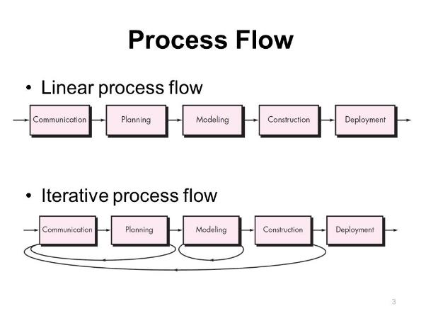
Process Flow
Linear process flow executes each of the five activities in sequence.

Slide 21
Process Flow
An iterative process flow repeats one or more of the activities before proceeding to the next.

Slide 22
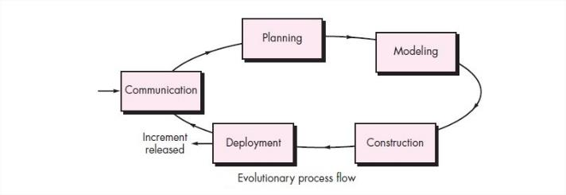
Process Flow
Evolutionary Process Flow
Notes:
An evolutionary process flow executes the activities in a circular manner.
Each circuit leads to a more complete version of the software.

Slide 23
Waterfall Model Process Phases
Testing
Gather Requirements
Specifications
Design
Implementation
Integration
Product

Slide 24
Waterfall Model
Each stage leads on to the next
No iteration or feedback between stages
There is testing after each phase

Slide 25
Risks With The Waterfall Model
The major risks are:
Relies heavily on being able to accurately assess requirements at the start
Little feed back from users until very late
Unless they understand specification documents
Problems in the specification may be found very late
Whole process can take along time before the first working version is seen
Sequential
The programmers have nothing to do until the design is ready

Slide 26
Rapid Application Development (RAD) Model

Slide 27
Rapid Application Development (RAD)
Team 1
Team 2
Team 3
Business
modelling
Business
modelling
Business
modelling
Business
modelling
Business
modelling
Business
modelling
Business
modelling
Business
modelling
Business
modelling
Data modelling
Data modelling
Data modelling
Data modelling
Data modelling
Data modelling
Data modelling
Data modelling
Data modelling
Process modelling
Process modelling
Process modelling
Process modelling
Process modelling
Process modelling
Process modelling
Process modelling
Process modelling
Application
generation
Application
generation
Application
generation
Application
generation
Application
generation
Application
generation
Testing and turnover
Application
generation
Application
generation
Application
generation
Testing and turnover
Testing and turnover
Testing and turnover
Testing and turnover
Testing and turnover
Testing and turnover
Testing and turnover
Testing and turnover

Slide 28
RAD Model
In RAD model the components or functions are developed in parallel as if they were mini projects.
The developments are time boxed, delivered and then assembled into a working prototype.
This can quickly give the customer something to see, use and to provide feedback regarding the delivery and their requirements.

Slide 29
Prototyping
Quick
plan
communication
Modeling
Quick design
Deployment
delivery &
feedback
Construction
of prototype
Construction
of prototype

Slide 30
Evolutionary Models
Prototyping:
Evolutionary prototyping is a lifecycle model in which the system is developed in increments so that it can readily be modified in response to end-user and customer feedback.
When to use: Evolutionary prototyping works best when the customer is uncertain about what they want at the outset and
In case of ambiguous, vague and blur problem definition
Their input must be solicited throughout the project to ascertain requirements
Notes:
Outset= SHURU
Vauge=Gool, Mool
Solicited= MANGI HOE
Ascertain=YAKINI

Slide 31
The Spiral

Slide 32
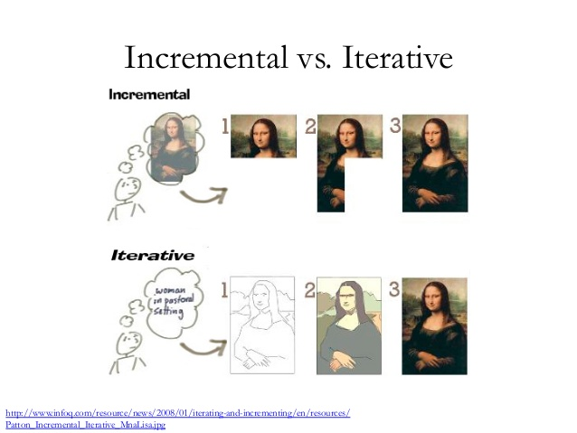
Incremental Model

Slide 33
Iterative VS Incremental Approach

Slide 34
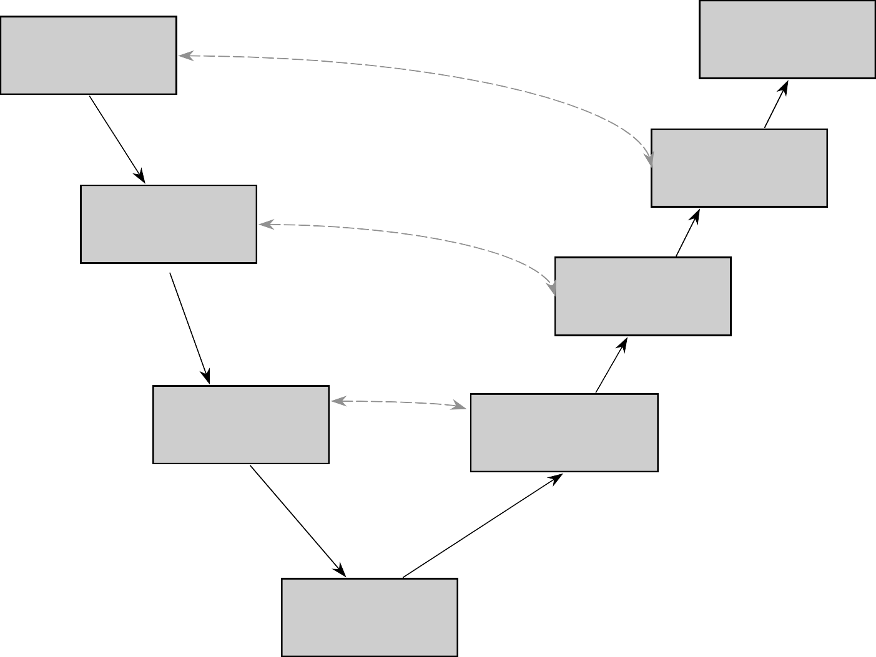
Linear Sequential Development V Model
REQUIREMENTS ANALYSIS
Validate requirements
OPERATION
& MAINTENANCE
ACCEPTANCE TESTING
SYSTEM DESIGN
SYSTEM TESTING
Verify design
PROGRAM DESIGN
UNIT & INTE- GRATION TESTING
CODING

Slide 35
Same Phases as in the Waterfall
Each development phase is matched by a corresponding
Veriﬁcation or validation phase
Top down design
Bottom up implementation
The whole product is designed before any of it is implemented

Slide 36
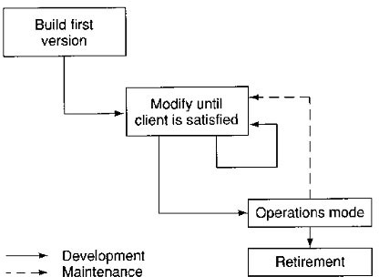
Build and Fix

